Slide 1
Integrated PreNatal Care
Team Members:
Aamleen Ahmed (2020002)
Mohd. Sufyan Azam (2020312)
Mohd. Shariq (2020220)
Notes:
Hi, we are group 29, and our project is Integrated PreNatal care, which is a set of integrated ML models to predict the complications that might arise during childbirth.

Slide 2
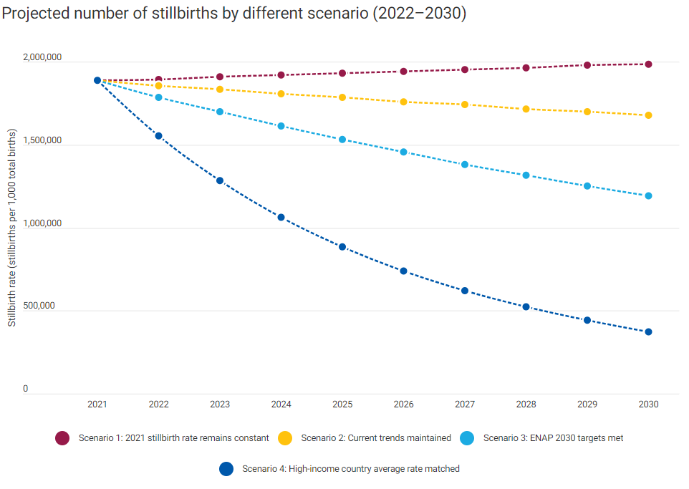
Motivation
The journey to parenthood is an extraordinary passage marked by joy and challenges. However, stillbirths, neonatal deaths, and preventable complications overshadow this miraculous process.
Our project is driven by an unwavering motivation to address this heart-wrenching issue. By leveraging the power of Machine Learning and analyzing a wealth of pre-natal data sources, we aim to provide healthcare professionals with a tool to predict potential health risks for mothers and fetuses.
With these insights, medical teams can make informed decisions, enabling timely interventions and a more coordinated approach to maternal and child health.
Through the fusion of data science and compassionate care, we envision a future where this integrated model significantly reduces the occurrence of tragic outcomes, paving the way for healthier beginnings and brighter tomorrows.
Notes:
Over centuries, there has been an alarming rate of still-births which even though have been decreasing, but are still in millions. Shocking part is that many of these can be easily avoidable if the complications are known before-hand. As per UNICEF, every 16 seconds there is a still-birth. So we can estimate that during this presentation duration only, there can be around 50 stillbirths.
Using the health parameters of fetus and mother, we plan to classify the risk in various segments so that a proper and timely action can be taken before it is too late for the little one.

Slide 3
Literature Review
Research Papers Summary

Slide 4
Paper 1
A Machine Learning Approach for the Prediction of
Fetal Health using CTG
Astik Kumar Pradhan; Jitendra Kumar Rout; Aurobinda Maharana; Bunil Kumar Balabantaray; Niranjan Kumar Ray et.al.
Discussion on machine learning techniques for the prediction of fetal health based on cardiotocography (CTG) data
CTG is a method for monitoring fetal heart rate and uterine contractions during pregnancy.
classifiers such as Logistic Regression, K-Nearest Neighbors (KNN), Random Forest, and Gradient Boosting Machine (GBM)
Model performance evaluation is conducted using metrics such as accuracy, precision, recall, and F1-score.
Random Forest model emerges as the most effective, achieving the highest accuracy rate of 0.99.
future research directions, the paper under-scores the potential for further enhancement in predictive model performance through the incorporation of additional preprocessing steps, such as linear discriminant analysis or principal component analysis.

Slide 5
Paper 2
Evaluation of support vector machines and random
forest classifiers in a real-time fetal monitoring sys-
tem based on cardiotocography data
Vinayaka Nagendra et.al.
Evaluation techniques for the foetal state prediction based on Cardiotocography (CTG) data are compared.
Extract features that potentially offer more details about the foetal status and assess the performance of these predictions in a real-time clinical decision support system.
Takes into account all three foetal states (normal, suspicious, and abnormal).
models like Support Vector Machines(SVM) and Random Forests (RF) are used
SVM performed marginally better for suspicious instances, although both SVM and RF had above 96% accuracy
Highlights importance of CTG data in forecasting the condition of the foetus during labour to show the danger of foetal acidosis (low blood pH from low oxygen levels)

Slide 6
Paper 3
Machine Learning Approaches for Early Diagnosis and Prediction of Fetal Abnormalities
R. Chinnaiyan and Stalin Alex
explored machine learning approaches for early detection of prenatal anomalies.
discussion on importance of early diagnosis of fetal anomalies, particularly in the first trimester,with the goal of lowering their occurrence rates and improving accuracy for ultrasound fetal imaging.
It involves four key steps: segmentation, image enhancement, feature extraction, and image classification.
Best model for our classification task is a Neuro Fuzzy Based Genetic Algorithm and the accuracy achieved through it was around 0.98

Slide 7
Paper 4
Machine learning to predict pregnancy outcomes: a systematic review, synthesizing framework and future
Muhammad Nazrul Islam et.al.
Focuses on ML techniques for predicting optimal childbirth modes and detecting complications.
Explores algorithms, features, data sources, and their performance in pregnancy outcomes.
highlights future research opportunities for reducing maternal complications and mortality rates, including unsupervised and deep learning algorithms, ML-based clinical decision support systems, dataset enhancement, and surgical robotic tools

Slide 8
DataSet
Description, Visualisation, PreProcessing

Slide 9
Description
The Cardiotocography (CTG) dataset used in this project is taken from the UCI Machine Learning Repository. Link: Dataset
It consists of measurements of features such as fetal heart rate (FHR) and uterine contraction (UC) on a device called cardiotocograph. Each CTG observation obtained is classified by expert obstetricians.
This dataset is multivariate and contains 2126 instances along with 40 features that can be used for classification purposes.
It can be used for classifying either the morphological pattern of the fetus (A, B, C, … columns) which is a 10-class classification problem, or the fetal state (N=Normal, S=Suspect, P=Pathological) which is a 3-class classification problem.
Notes:
we intend to work on both the 10 class and the 3-class classification problem to gain a comprehensive result of the fetus state. For this presentation, we have worked on the 3-class classification problem which classifies the fetal states into normal, suspect, or pathological states. This dataset is licensed under a Creative Commons Attribution 4.0 International (CC BY 4.0) license. This allows for the sharing and adaptation of the datasets for any general purpose,.

Slide 10
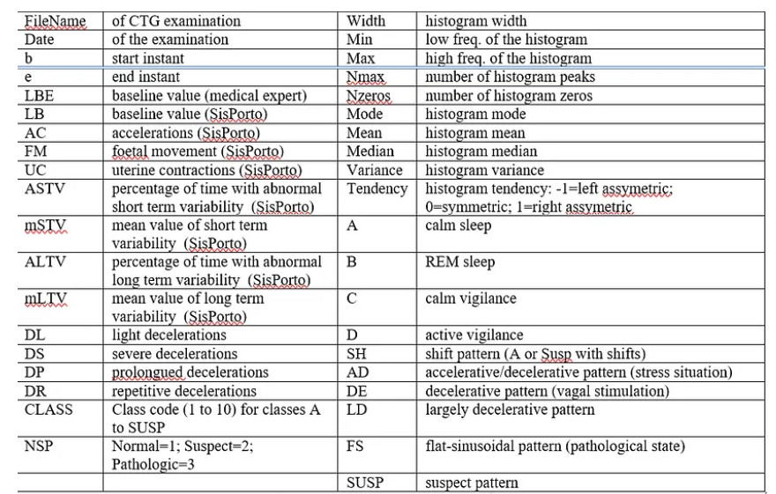
Description - Header Details
Notes:
we intend to work on both the 10 class and the 3-class classification problem to gain a comprehensive result of the fetus state. For this presentation, we have worked on the 3-class classification problem which classifies the fetal states into normal, suspect, or pathological states.

Slide 11
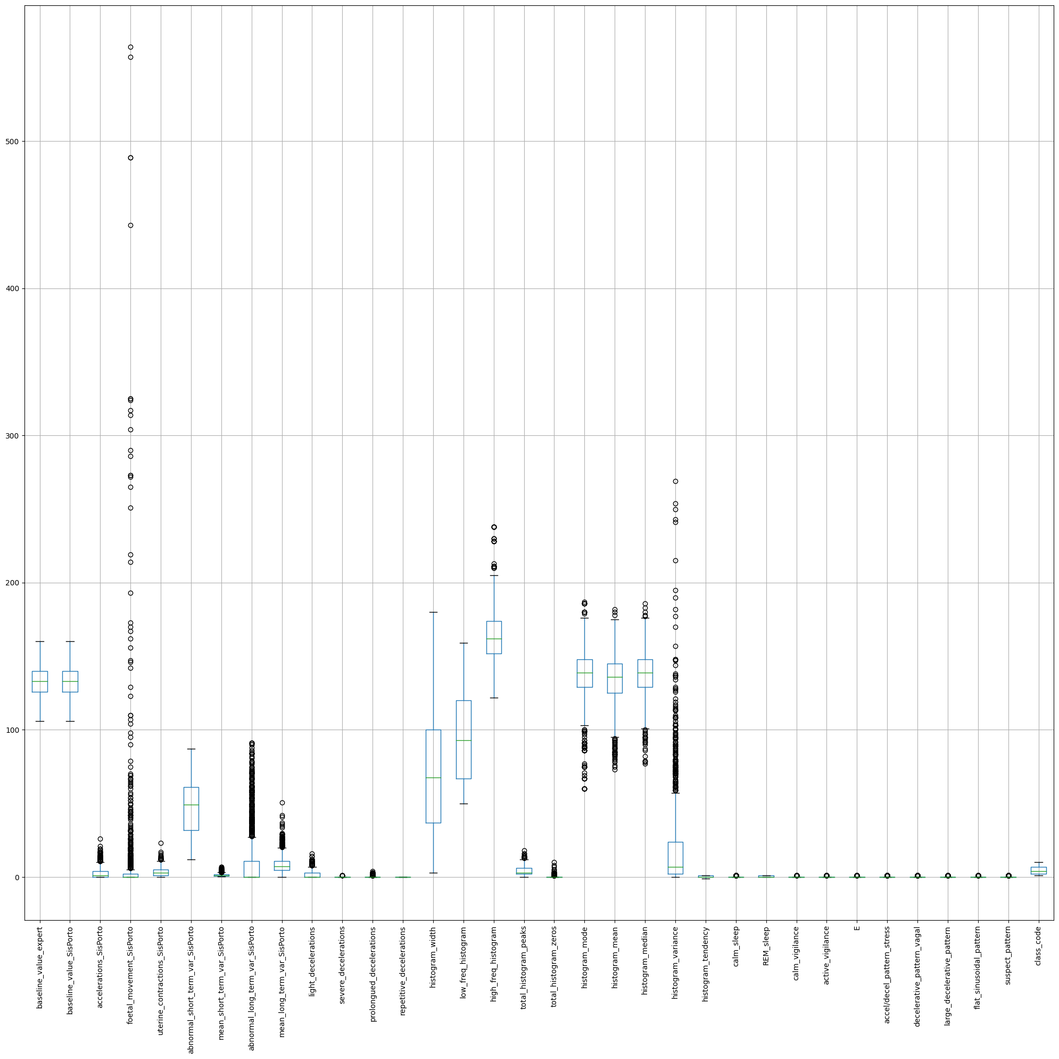
Visualization - Box Plot for Outliers

Slide 12
Preprocessing - Handling Outliers
We checked for the presence of outliers using boxplots and removed them by using a variety of methods -
Z-Score normalization: Maps the data to a normal distribution with mean 0 and standard deviation 1;
KNN Imputer: Replaces outliers with the mean of their nearest neighbors;
Inter-Quartile Range: Maps the difference between quartiles and removes values outside a certain range.
Robust Covariance: Uses robust estimator for the covariance matrix and removes values above a threshold.
The best performing method among them for our dataset was the Robust Covariance Method.
Notes:
Our aim was to compare multiple methods for outlier removal and take the best method which works on our dataset. Taking a Z-score is simply mapping the data onto a distribution whose mean is defined as 0 and whose standard deviation is defined as 1.

Slide 13
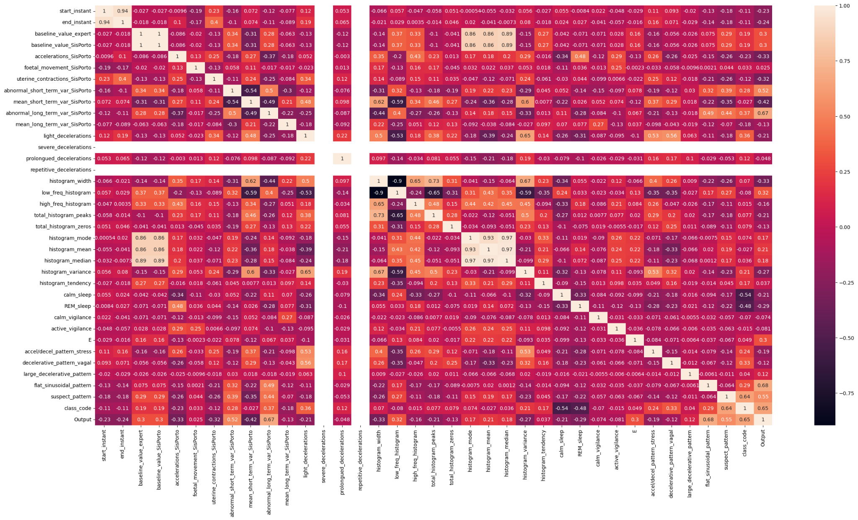
Visualization - Correlation Heatmap
Notes:
13 features were removed approximately from the correlation heatmap

Slide 14
Preprocessing - Feature Engineering
We achieved feature engineering by making strategic decisions to enhances model efficiency and interpretability through the help of the correlation heatmap.
We identified certain columns that exhibited high correlation among each other, indicating redundancy in our feature set and removed them.
We also eliminated columns with extremely low correlation with the output data, suggesting minimal relevance in predicting fetal health and prenatal complications.
We also removed columns such as FileName, Date, etc that didn’t have an impact on the predictions.
Notes:
In the interest of simplifying our models and improving their performance, we opted to remove these less informative columns.

Slide 15
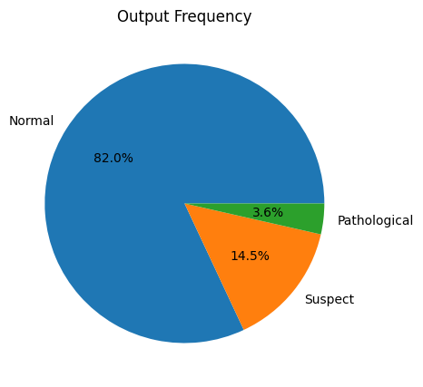
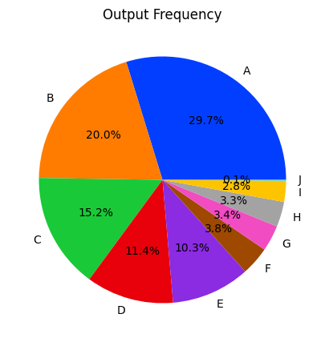
Preprocessing – Output Class Imbalance
Context:
Applied to 3-class classification due to class imbalance.
Not extended to 10-class classification with nearly uniform data distribution.
Imbalance Challenge:
Imbalanced classes risk bias towards dominant class, resulting in inaccurate outcomes.
Resampling Techniques
Utilized SMOTE and NEAR-MISS algorithms to address heavy imbalance.
Specifically applied due to the dataset being skewed towards the normal class.
3-class
10-class
Notes:
When classes in the output label are not evenly distributed, the class imbalance problem occurs.

Slide 16
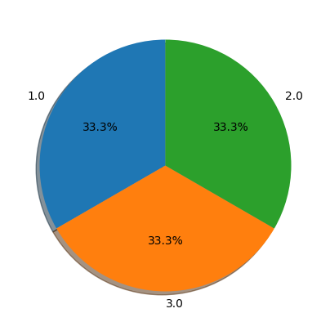
Preprocessing - Resampling Techniques
Oversampling with SMOTE:
Utilizes synthetic sample creation to address imbalances.
Selects minority instances and generates new samples along connecting lines.
Undersampling with NEAR-MISS:
Randomly removes data from the majority class for balance.
Uses the NEAR-MISS algorithm to enhance classification but may lead to underfitting due to reduced total records (1000).
Did not use Resampling in 10 class classification due to data scarcity per-class, and data was more or less equally distributed.
Notes:
Its purpose is to make the data more evenly distributed.

Slide 17
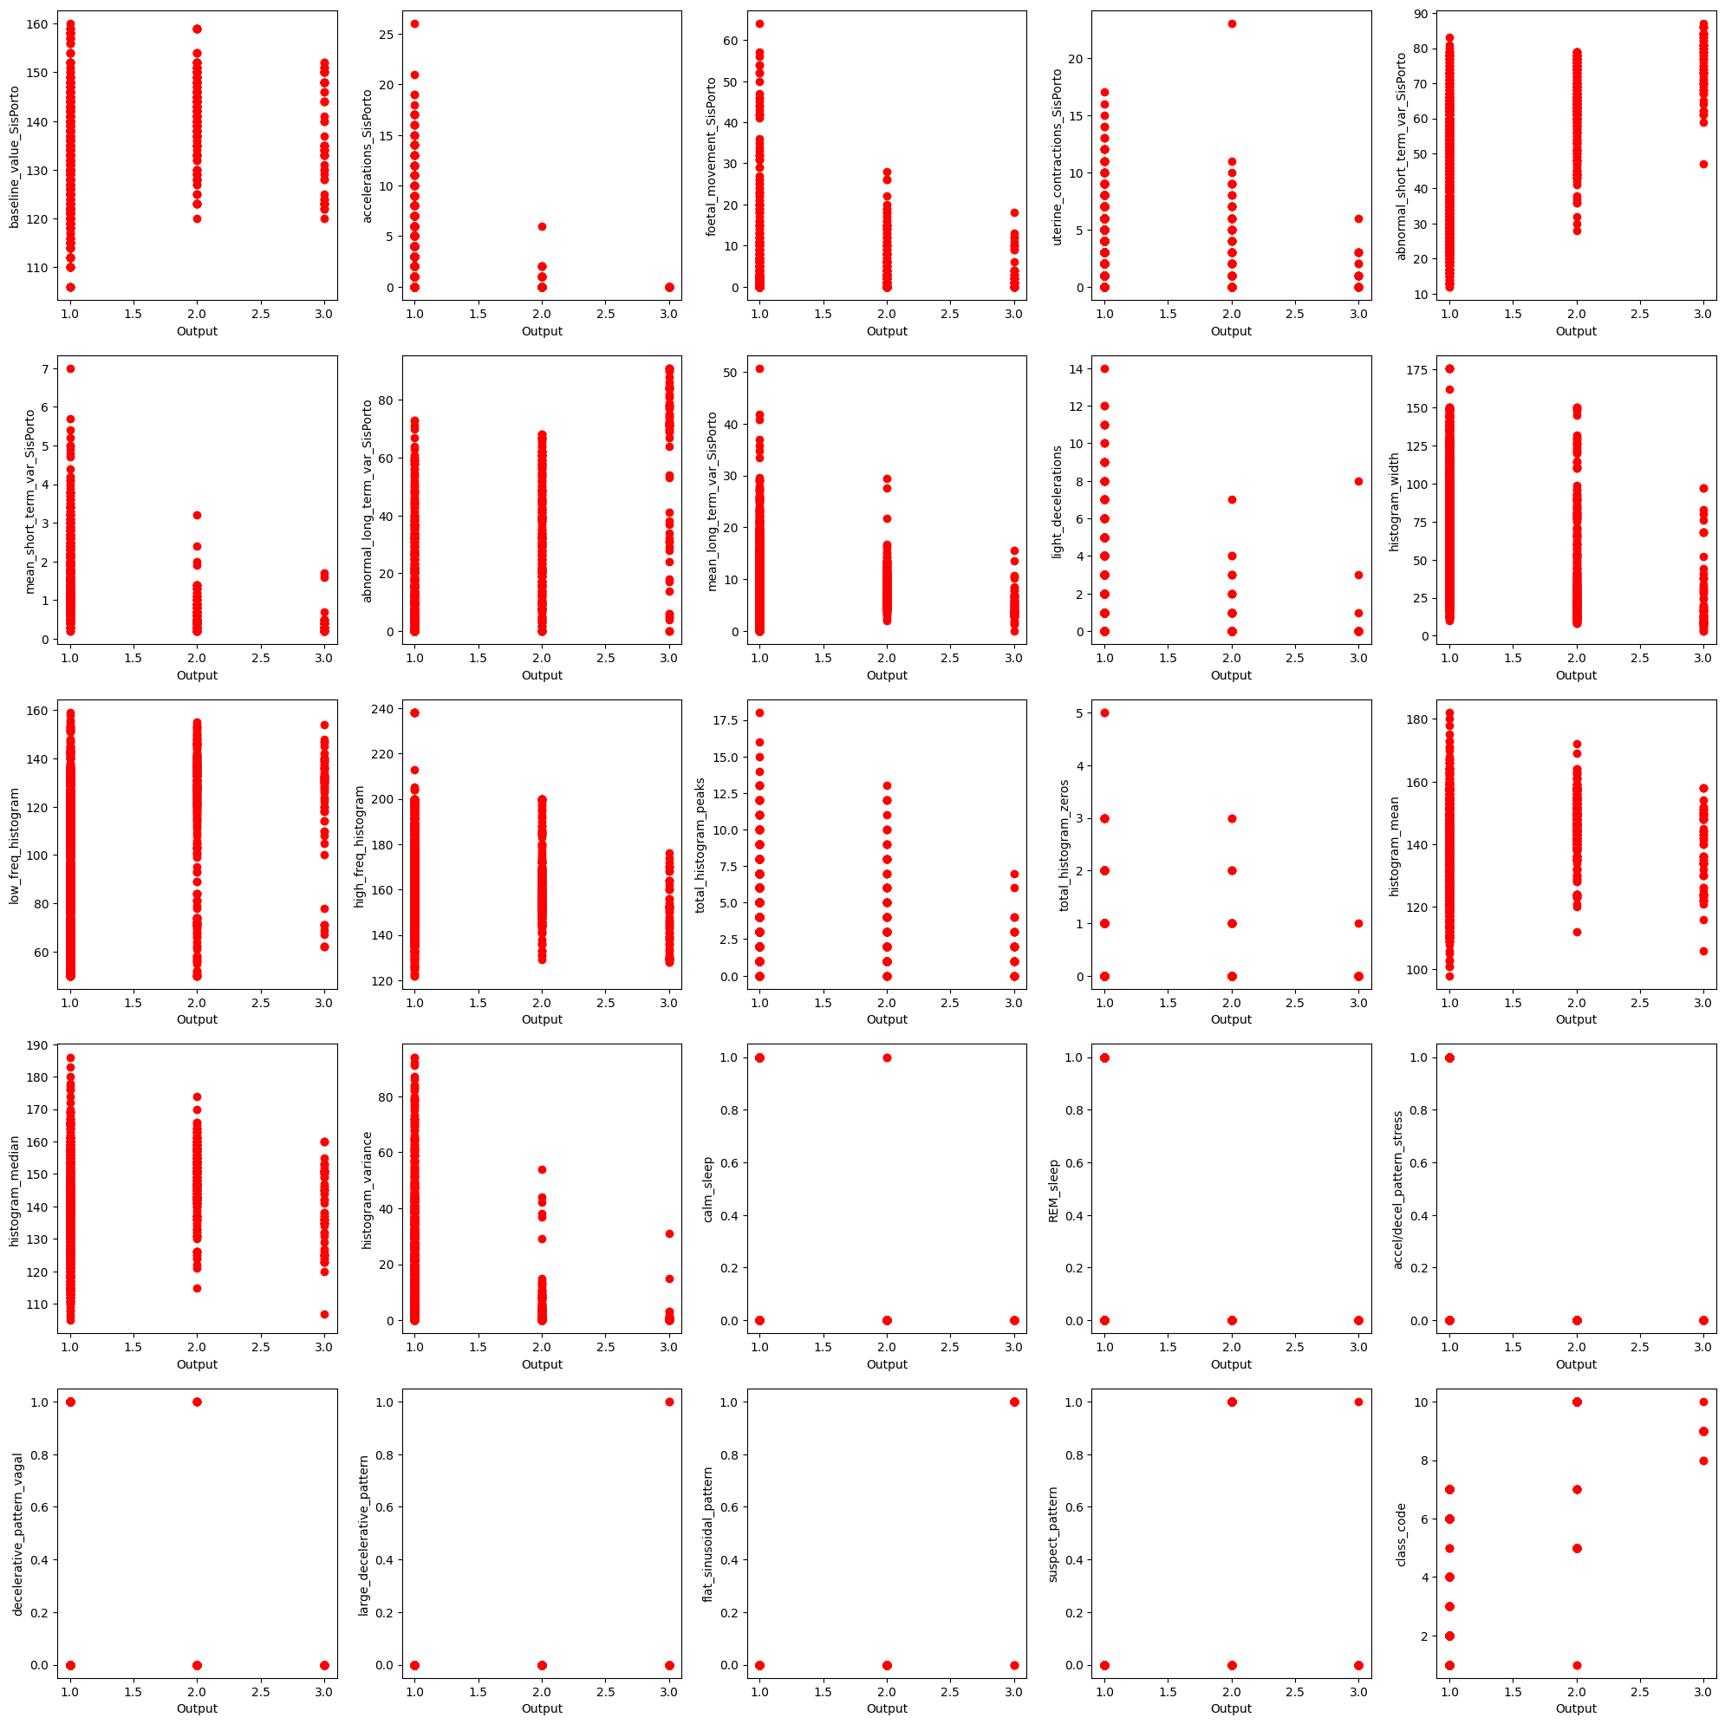
Visualization - Scatter Plots

Slide 18
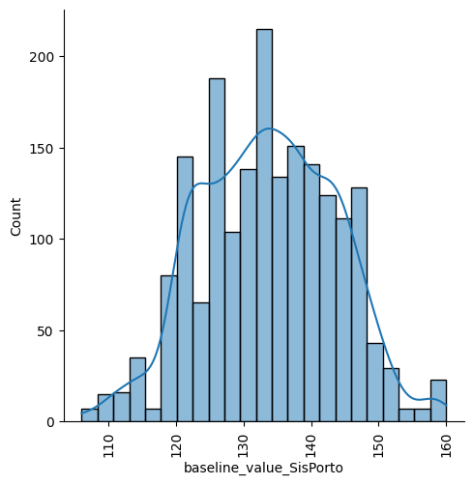
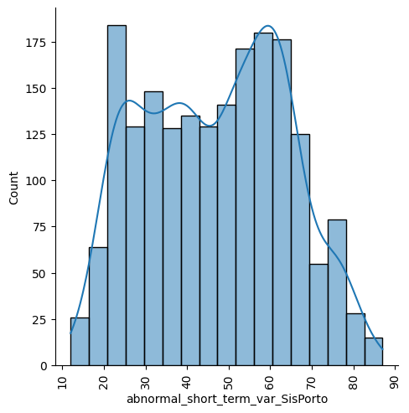
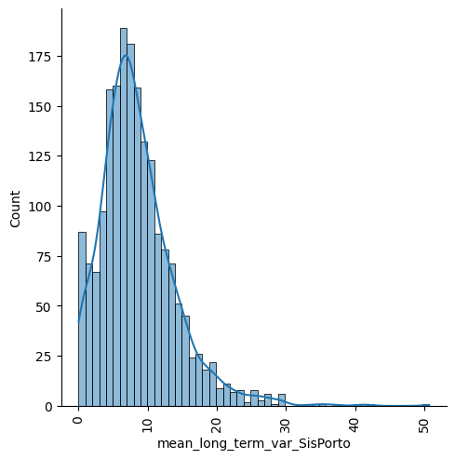
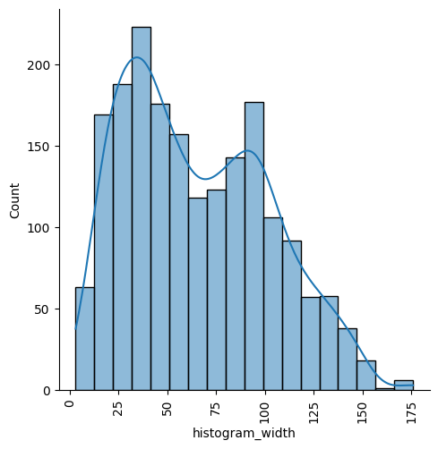
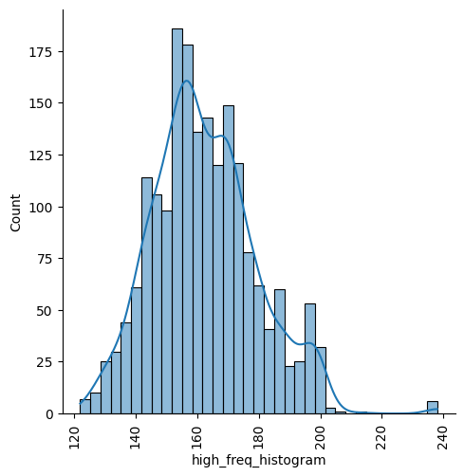
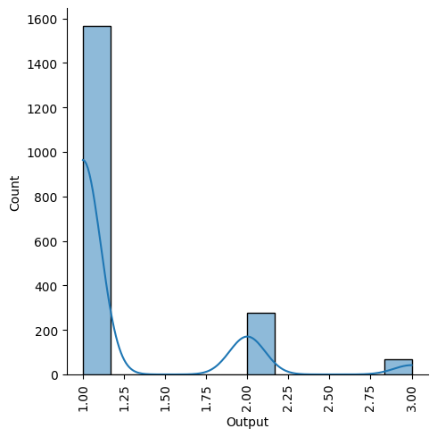
Visualization - Distribution Plots

Slide 19
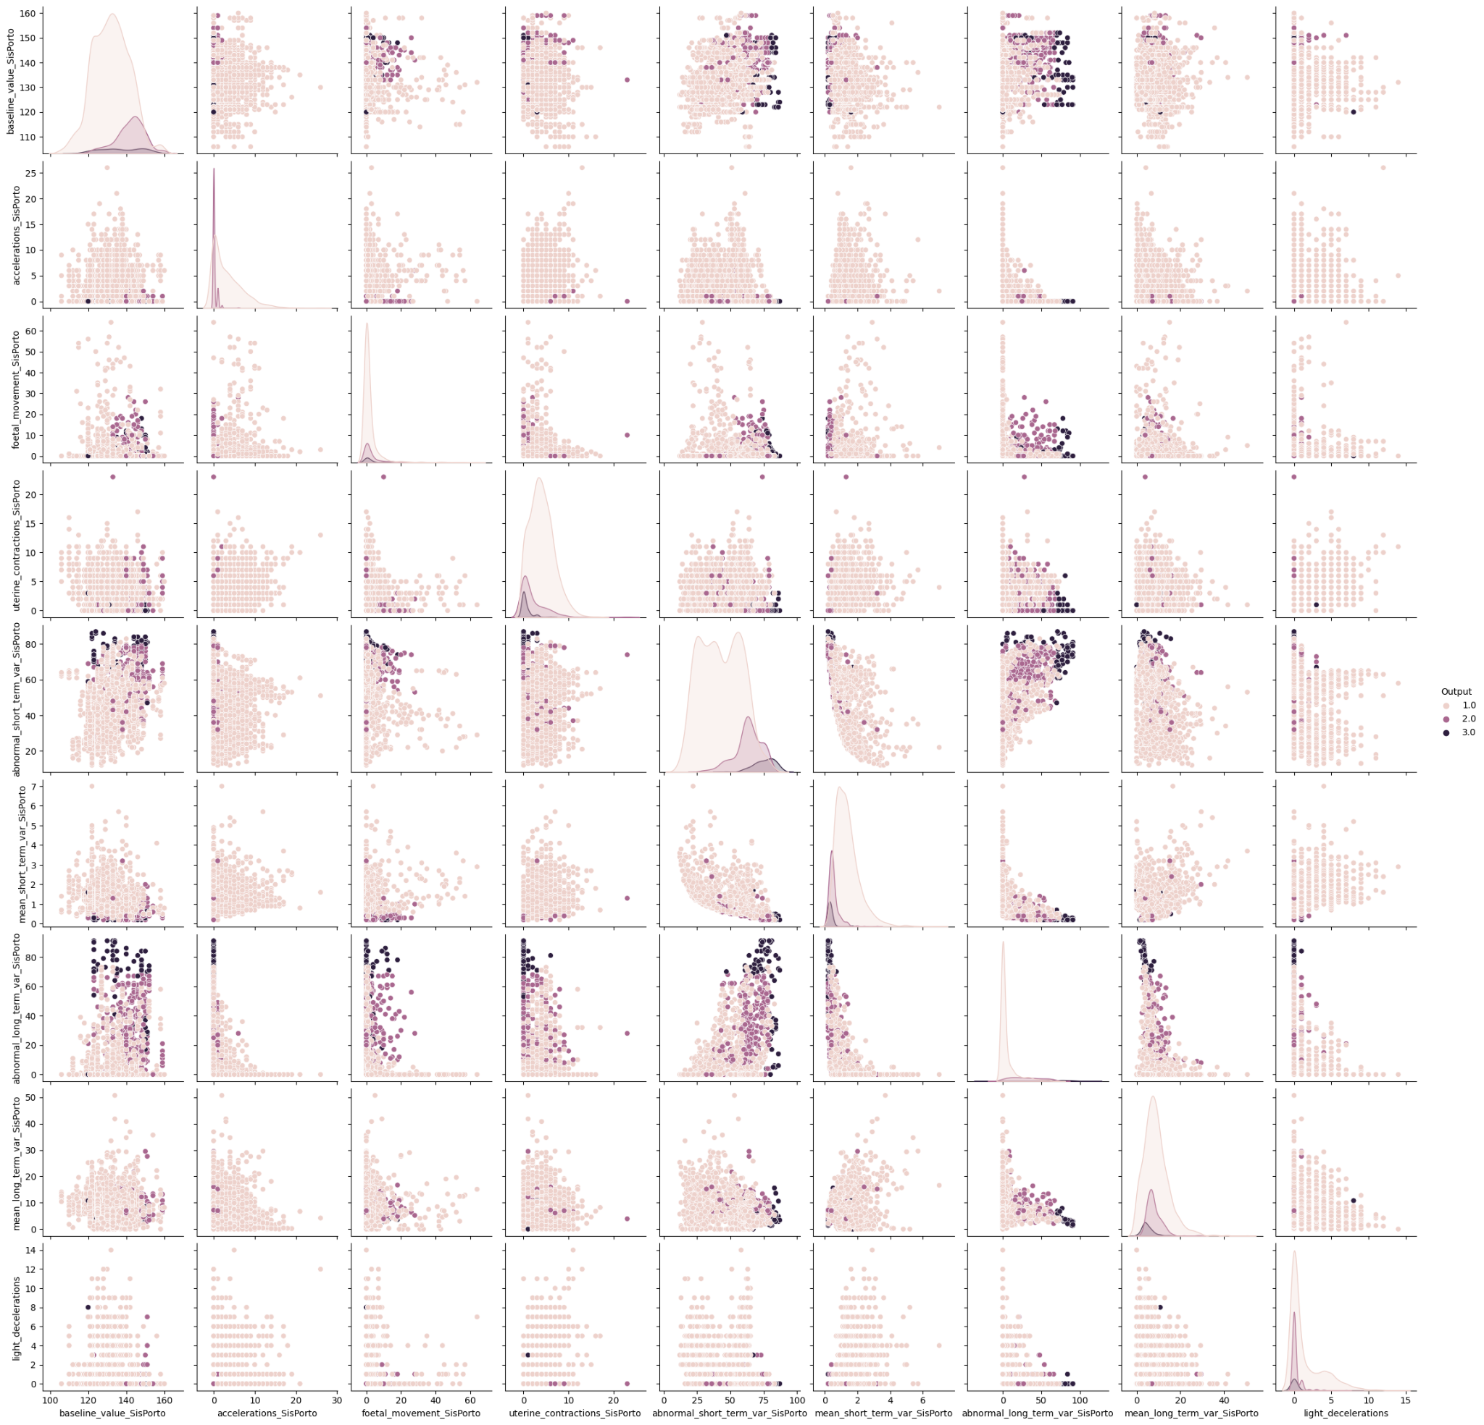
Visualization - Pair Plots

Slide 20
Methodology
Models Used, Overfitting Avoidance

Slide 21
Overfitting
Due to lack of a large dataset, our model was overfitting, as we were getting very high training scores ~100%, but testing scores were limited to 80-90%. So we explored the following methodologies:
PCA: Principal Component Analysis, employed for dimensionality reduction, significantly improved our model's generalization capabilities, enhancing accuracy and mitigating overfitting.
Regularization (L1 and L2 using liblinear): The application of L1 and L2 regularization methods with the liblinear solver helped control overfitting by optimizing feature coefficients, ultimately leading to more stable and reliable models.
K-Fold Cross-Validation (K=10, 3, 5): We used 10-fold, 3-fold, and 5-fold cross-validation techniques to rigorously evaluate our models, ensuring robustness and accuracy across different validation scenarios.

Slide 22
Models
1. Logistic Regression (LR): Foundational understanding with F1 scores of 0.72 (3-class) and 0.68 (10-class).
2. K-Nearest Neighbors (KNN): Solid performance with F1 scores of 0.82 (3-class) and 0.78 (10-class).
3. Support Vector Machines (SVM): High F1 score of 0.87 (3-class) in distinguishing fetal states.
4. Naive-Bayes: Limitations in capturing dependencies with an F1 score of 0.66 (3-class). Baseline
5. Decision Trees: Prone to overfitting, concerns about performance on unseen data, especially in the 3-class scenario.

Slide 23
Models
6. Random Forests: Effective in mitigating overfitting, achieving F1 scores of 0.85 (3-class) and 0.8 (10-class).
7. XGBoost: Demonstrated solid performance with an F1 score of 0.79 (3-class) and 0.76 (10-class).
8. CatBoost: Improved F1 score to 0.8+ in the 10-class scenario, showcasing enhanced suitability for datasets with categorical features.
9. Artificial Neural Network (ANN): Stood out as the most powerful model, achieving the highest F1 score of 0.92 (3-class) and 0.88 (10-class) for predicting intricate patterns in prenatal health data.

Slide 24
HyperParameter Tuning
In addition to model evaluation, we performed hyperparameter tuning using GridSearchCV for models like SVM, XGBoost, etc., to obtain the best configurations for improved performance.
Optimization Parameters: max_iters, max_depth, learning_rate, solver, loss, etc.
For the Artificial Neural Network (ANN), we utilized Keras Tuner to determine the optimal layer size and number, striking a balance between computational complexity and achieving a high F1 score in our 3-class classification model.
Similar tuning was done for 10-class classification model, but on a smaller scale around the tuned parameters of 3-class model.

Slide 25
Results (3-Class Foetal Risk)
Model | Accuracy | F1 Score | Recall | Precision
Logistic Regression | 79% | 0.7 - 0.86 | 0.67 - 0.86 | 0.72 - 0.85
Naive Bayes | 72% | 0.63 - 0.78 | 0.63 - 0.81 | 0.63 - 0.79
K-Nearest Neighbors | 88% | 0.87 - 0.9 | 0.88 - 0.9 | 0.87 - 0.91
SVM | 93% | 0.92 - 0.96 | 0.91 - 0.97 | 0.9 - 0.96
Decision Trees | 100% Tr | 84% Te | N/A | N/A | N/A
Random Forest | 88% | 0.84-0.9 | 0.87-0.9 | 0.85-0.88
XGBoost | 85% | 0.8-0.86 | 0.82-0.87 | 0.82-0.87
ANN | 97% | 0.96-0.99 | 0.97-0.99 | 0.97-0.99

Slide 26
Results (10-Class Morphological Pattern)
Model | Accuracy | F1 Score | Recall | Precision
Logistic Regression | 68% | 0.64 - 0.66 | 0.67 - 0.69 | 0.65 - 0.66
Naive Bayes | 57% | 0.56 - 0.58 | 0.57 - 0.59 | 0.58 - 0.61
K-Nearest Neighbors | 76% | 0.74 - 0.78 | 0.75 - 0.77 | 0.73 - 0.76
SVM | 79% | 0.79 - 0.83 | 0.8 - 0.81 | 0.78 - 0.8
Decision Trees | 95% Tr | 67% Te | N/A | N/A | N/A
Random Forest | 70% | 0.69-0.73 | 0.7-0.72 | 0.68-0.72
XGBoost | 73% | 0.72-0.74 | 0.71-0.73 | 0.73-0.75
CatBoost | 81% | 0.81-0.82 | 0.81-0.83 | 0.82-0.84
ANN | 87% | 0.88-0.9 | 0.86-0.89 | 0.88-0.92

Slide 27
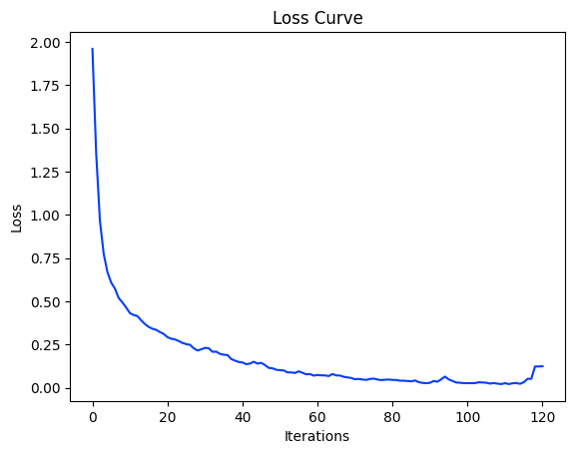
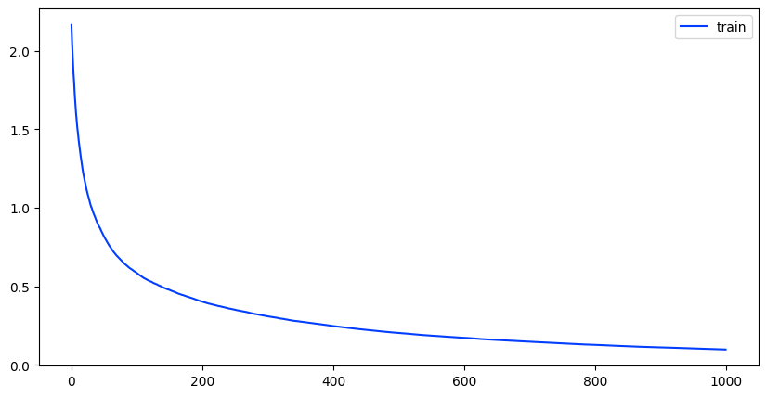
Some Plots
CatBoost Loss Curve
ANN Loss Curve
Note: We could not add an image here due to size and formatting (Click here). Rest of the plots are on the notebook.

Slide 28
Inferences
1. Data Scarcity: Overfitting issues were more prevalent in the 10-class model due to limited data.
2. Deep Learning: ANN's dominance underscores the importance of deep learning in capturing complex health patterns.
3. Data Characteristics: Differences in regularization, PCA usage, and clustering highlight the impact of data distribution and scarcity on performance.
4. Optimized Configurations: Consistent patterns in tuned hyperparameters suggest certain configurations are universally effective, improving accuracy and generalization.
5. Insights Transferability: Insights from both 3-class and 10-class challenges can enhance understanding of prenatal healthcare and predictive modeling.

Slide 29
TimeLine
Past Timeline
Future Timeline (After Midsem)
Week | Work Done
2 | Project Ideation, Literature Review
3 | Dataset: Understanding & Visualisation
4 | Dataset: PreProcessing
5 | Preprocessing (contd.), Logistic Regression, K-fold CV, PCA
6 | Naive Bayes, k-NN, SVM
7 | Decision Trees, Pruning
Week | Work Done
8 | Random Forests
9 | Boosting, ANN
10 | HyperParameter Tuning, GridSearchCV
11 | Preparing Another 10-class Model on the basis of Mother’s health
12 | Analyzing & Integrating Models (Tentative)
13 | Final Report & Presentation

Slide 30
Contributions
Work | Contributors
Ideation | Aamleen, Sufyan
Literature Review | Mohd. Shariq
Dataset: understanding & analysis, preprocessing, visualisation. | Mohd. Sufyan
Methodology: Models implementation, Optimizing parameters. Future possibilites | Aamleen Ahmed
Analysis of results | Mohd. Sufyan, Aamleen Ahmed
Report formation | Mohd. Shariq

Slide 31
Appendix
Link for the Code
Link for the Report

